Slide 1

CPE 490 Embedded Systems Lecture 19
FreeRTOS
Binary and Counting Semaphores
Data acquisition and manipulation (Wilmshurst Text Chapter 11)
Much of this presentation comes from www.freertos.org tutorial
As well as “Using the FreeRTOS Real Time Kernal, A Practical Guide”, Richard Barry, 2010 version 1.3.2.

Slide 2
Counting Semaphores
A counting semaphore can take a number of ‘gives’ before a ‘take’ occurs
What happens if interrupts can occur at high frequency over a short period of time?
Counting Semaphore can be thought of a queue of n elements
A binary semaphore might get overrun as seen in the next slide

Slide 3
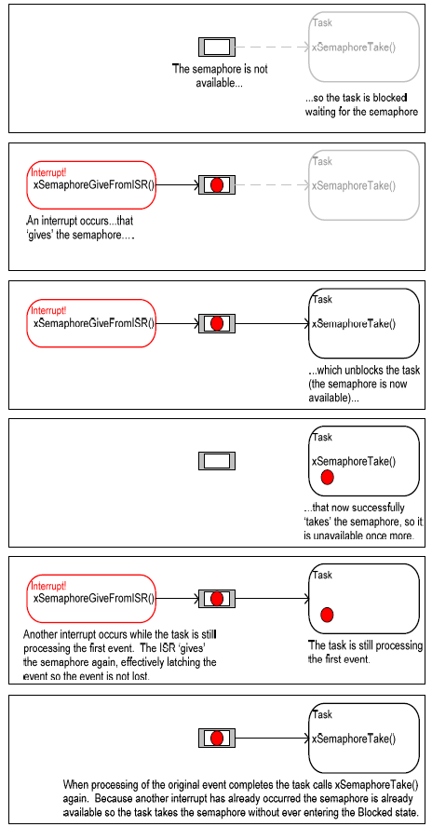
Limit of Binary Semaphore

Slide 4
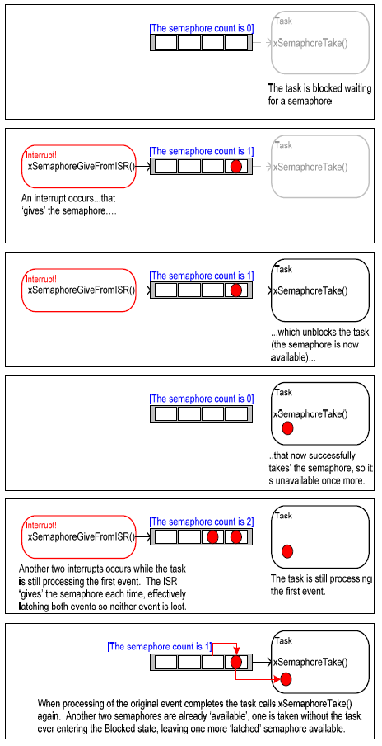
Counting Semaphore
Notes:
At the point that two interrupt events occur as in the 5 frame of the graphic the binary semaphore would be overwhelmed.

Slide 5
2 Ways to Use Counting Semaphore
Counting events
A semaphore is given each time an event occurs
A semaphore will be taken each time processing of the event occurs
The count is the difference between the ‘gives’-’takes’
Resource Management
Count represents the number of resources are available. To start, the number of semaphores = the number of resources. Every time a resource is taken a semaphore is taken, when done it is given back.

Slide 6
Creating a Counting Semaphore
Prototype
xSemaphoreHandle xSemaphoreCreateCounting(
unsigned portBASE_TYPE uxMaxCount,
unsigned portBASE_TYPE usInitialCount );
uxMaxCount: max number of semaphores in queue
uxInitialCount: Initial number of semaphores in queue
Return: Null or handle to the semaphore queue

Slide 7
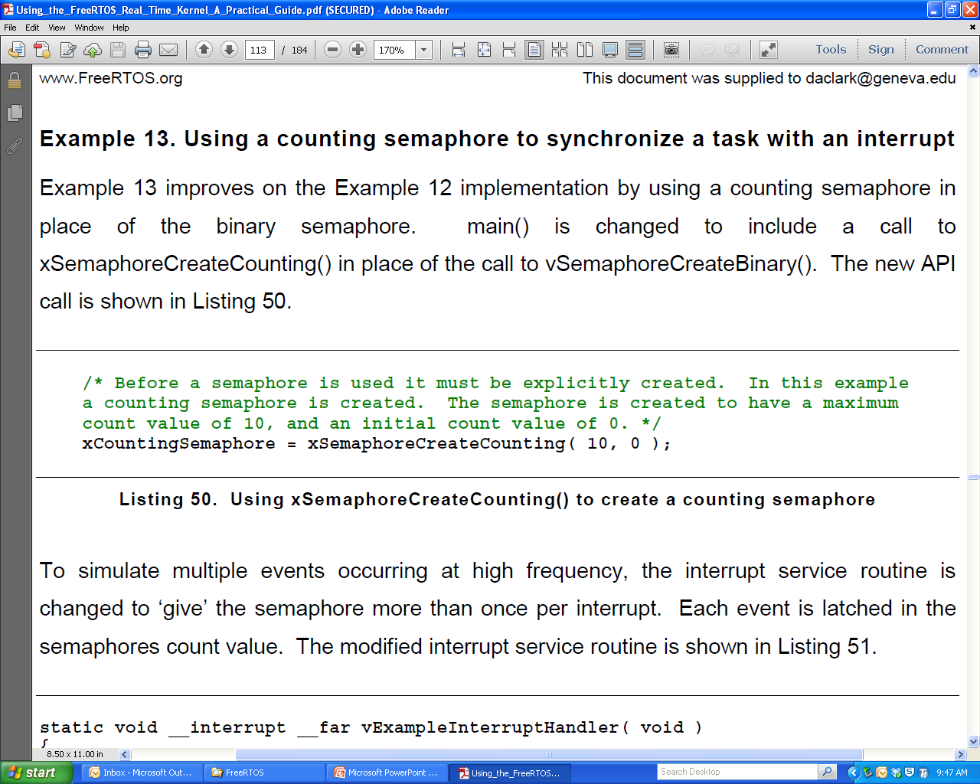
Counting Semaphore Example
This example uses the previous taking task and main (), just add the following to the main() code.

Slide 8
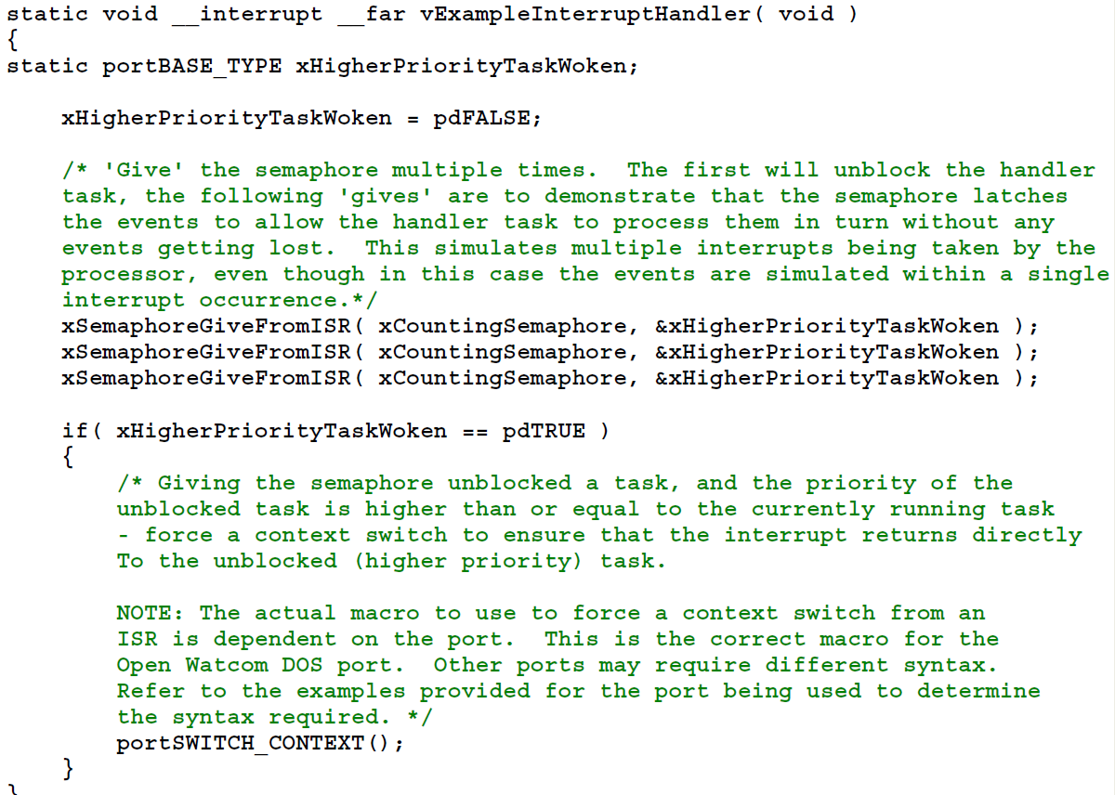
Example ISR
Notes:
Notice three gives in a row before the context is switched to the handler

Slide 9
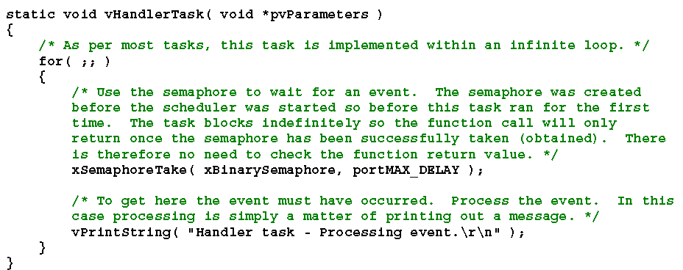
Example Handler Task

Slide 10
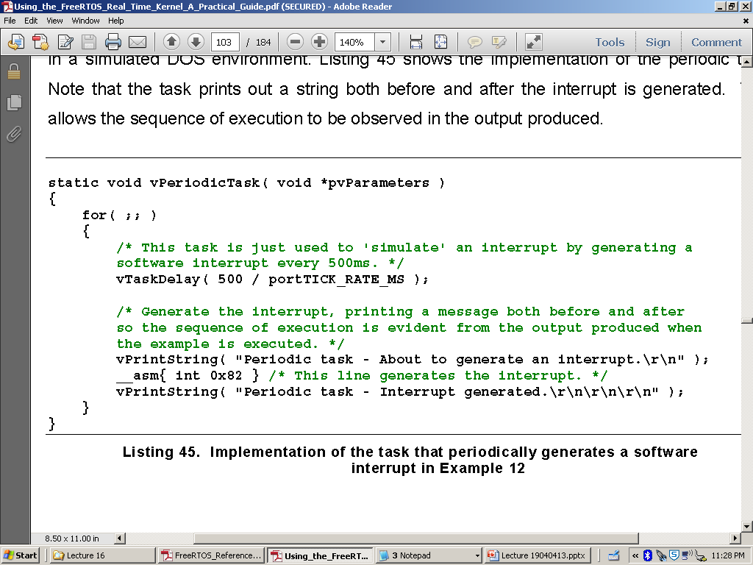
Binary Semaphore Example

Slide 11
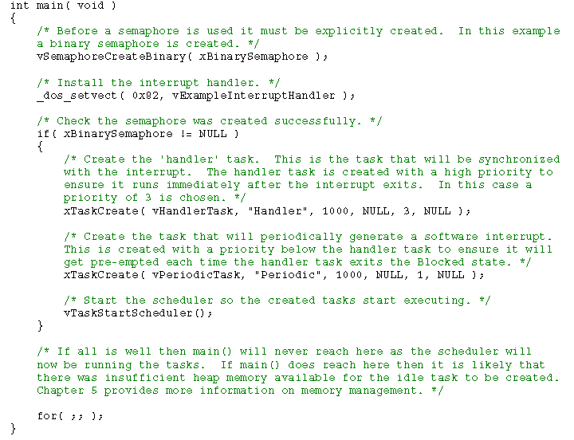
Example Main()

Slide 12
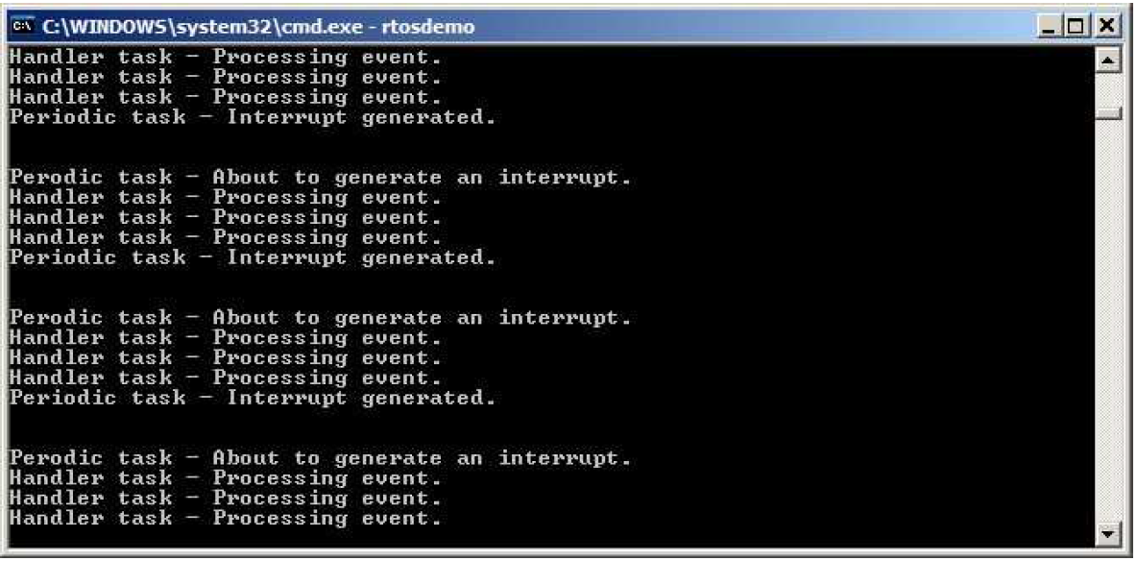
Example Output

Slide 13
Data Acquisition
The process of converting an analog signal to digital, along with all the attendant signal manipulation

Slide 14
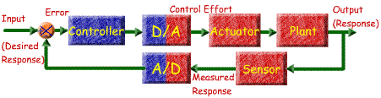
Data Acquisition in Context
Micro Controller
Notes:
This is an example of a close loop control signal that uses both DAC and ADC functionality. If we are talking wheel speed:
The input is the desired torque
the actuator is the PWM pulse train,
the plant is the DC motor
The sensor is reading the current in the motor coil and outputting a representative analog signal
The ADC turns that value into a digital representation

Slide 15
Problems in Data Acquisition
Sampling will always cause some sampling error
Sampling will always cause loss of frequency content. If we sample at rate of X Hz then we can only have a frequency content up to X/2 Hz.
0111 1000
True Analog Value
Sampling error
0111 0111

Slide 16
A Data Acquisition System
When converting an analog signal to digital form, it is usually not enough just to find a suitable ADC (Analog to Digital Converter). Usually, more than one input is required and the signal needs processing before it can be converted. In most cases, therefore, it is necessary to build up a complete data acquisition system. The elements of such a system are shown below. This shows, in block diagram form, a system with multiple inputs, amplification, filtering, source selection, sample and hold, and finally the ADC itself. The different elements are outlined in the sections which follow.
Filter
Multiplexer
Removes unwanted
Selects which
ADC
signal components,
input channel is
Converts its
Voltage
Transducer
usually for
anti-
connected to its
Analog
Input to a
Generates signal
aliasing
purposes
output
Sample & Hold
Digital Output
Reference
Samples its input
signal, and holds
that voltage as a
steady value at its
output
Sample
Digital
Output
Amplify and Offset
Input Select
Start
Output
Amplifies signal and
Conversion
Result
CPU
adds DC offset, to
Conversion
Control
match ADC input
Complete
range.

Slide 17
Amplification and Signal Condition
In order to fully take advantage of the resolution and accuracy of the ADC try to match the signal range to the ADC range by using amplification or sometimes reduction
To only use half of the scale is like lowering the resolution of the convertor by 1 bit.
Some time signal is bi-polar and ADC is single rail then a level shifting needs to be done

Slide 18
Why Buffer Amplification
Say a sensor has a source impedance of 1K Ω
Say the Reading circuit has an impedance of 50K
Because of the voltage divider a 2% error exists.
If you use a buffer with say 1 M Ω input impedance and 50 Ohms output impedance than the error goes to .1% + .1% = .2%
Notes:
Draw this on the board. In non buffer case the voltage at 50 k will be 50/51 = .9804
In buffer case first 1e6 / (1e6 + 1e3) = .999 , second case 50k / (50k + 50) = .999

Slide 19
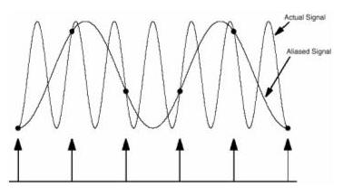
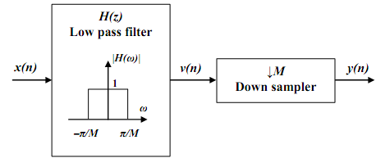
Anti Aliasing
Use a low pass filter to attenuate analog signal before sampling

Slide 20
Analog Multiplexer
Multiplexer can allow one ADC to be used on many signals but sampling rate could go down.
Sometimes simultaneous sampling is needed to get accurate results and the multiplexer can’t be used.
The resistance in the switch can slow down the time needed for the sample and hold
Multiplexer
Selects which
input channel is
connected to its
output
Input Select

Slide 21
The Sample and Hold Circuit
Because most ADCs work better converting a stationary voltage, a Sample and Hold circuit is commonly used. In this type of circuit a capacitor is charged from a source which inevitably has some resistance. Further resistance comes from internal resistance of the solid-state switch used in the S&H, and/or in the multiplexer. Therefore the capacitor takes finite time to charge, with a charging characteristic as shown.
A Simple Form of Sample and Hold Circuit
Charging Characteristic of Sample & Hold
Notes:
So how close to Vs must you get, lets say to ½ bit. So an 8 bit converter is 1/255* 1/2 = .196% or X = .9980. This gives a t of RC 6.238

Slide 22
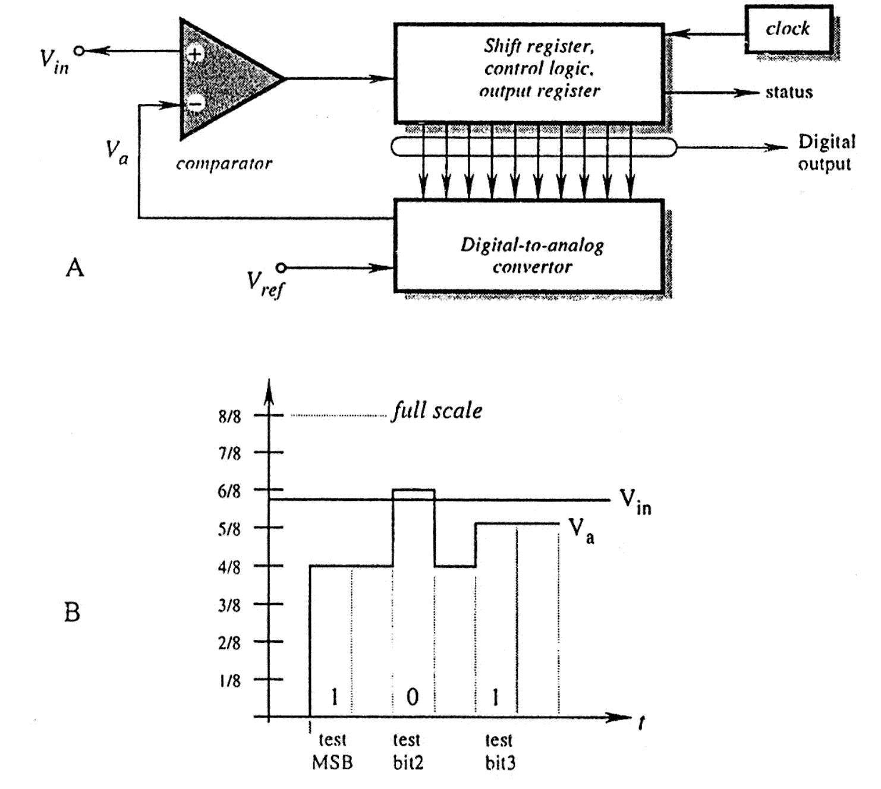
Successive Approximation A/D
Notes:
This is the type of A/D convertor in the dsPIC

Slide 23
The Analog to Digital Converter (ADC)
The ADC accepts an input voltage that is infinitely variable, and converts this to one of a fixed number of output values. An example ADC conversion characteristic is shown, where the input voltage is represented on the horizontal axis, and digital output on the vertical.
For an n-bit ADC, the maximum output value will be (2^{n} – 1). For example, for an 8-bit ADC, the maximum value will be (2⁸ – 1), or (256 – 1), i.e. 255 decimal or 11111111 binary.
Min 0 V = Code 0
Max V_{max} = Code 2^{n} – 1
Resolution = V_{max} /(2^{n} – 1)
Code = D = e/V_{max} (2^{n} – 1)
Digital
Output
n
(2 - 1)
n
(2 - 2)
100
011
010
...001
0
Analogue
0
V
max
Input
Input Range
Notes:
Notice that the change to a code will ideally happen in ½ of the interval of resolutions
Also note that the text has the resolution wrong when it states it is V/2^N

Slide 24
ADC
The voltage reference is the standard that is used to find ADC values. The ADC can only be as accurate the voltage reference
ADC
Converts its
Voltage
Analog
Input to a
Reference
The conversion speed of the ADC puts a limit on the bandwidth of the signal you are measuring.
Digital interface between processor and ADC can be parallel or serial (SPI, I^2C)
Digital Output
Digital
Output
Output
Result
CPU
Conversion
Control

Slide 25
Location of ADC
Two choices:
Integrated in the microcontroller
Separate with some type of interface to the processor
A microcontroller is an electrical noisy place.
Remember many (10s of thousands) transistors change on every clock edge
Hard to get better than 10 bit performance
I separate ADC can be isolated on the PCB to be in a quiet zone.

Slide 26
Typical Timing Requirement of one A to D Conversion
Configure & enable ADC
Select
Multiplexer
input
These stages merge
if
multiplexer
forms
“Sample” Input Signal
part of S&H
Delay for signal acquisition
“Hold” Input Signal
Start Conversion
Delay for conversion
to complete
Read Data

Slide 27
Integrating an ADC onto the Microcontroller
It is now possible to integrate much of a data acquisition system onto a single chip, and/or into a microcontroller. But note - ADCs don’t easily integrate onto microcontrollers, mainly because there is the risk of massive digital interference, both radiated, and through shared earth and supply lines.
A partial solution is to separate the ADC earth and supply from that of the microcontroller, and to minimise interference during conversion - by synchronising conversion to internal clock transitions, and minimising all other switching at this time.
Ultimately, you will only find ADCs of limited resolution (generally 8- or 10-bit) integrated onto a microcontroller.

Slide 28
dsPIC33FJ256GP710A ADC
There are 2 SAR ADCs: ADC1, and ADC2
Each can be configure for 12 or 10 bit operations
Up to 32 analog input pins
The chip is capable of sampling 1.1 million times a second in 10 bit mode, 500 thousand times a second for 12 bit mode
Engineering tradeoff resolution for speed
Notes:
1.1 million times a second is period of 909 ns
500 thousand times is a period of 2 useconds

Slide 29
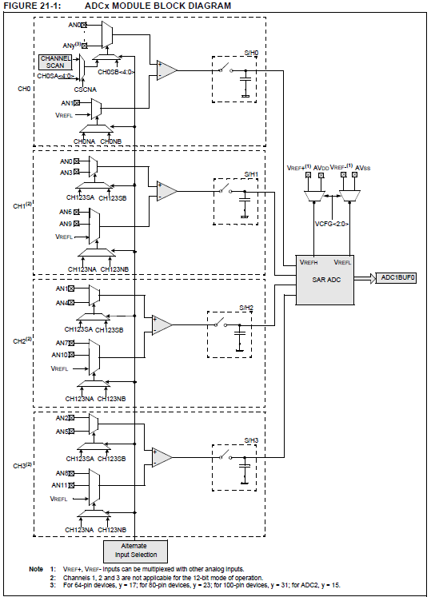
12 bit mode only uses S/H Channel 0
This is a model of ADC1 it can use all 32 inputs.
ADC2 is not shown it can use the first 16 analog inputs

Slide 30
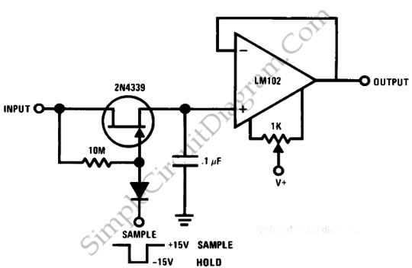
A Sample and Hold Circuit
Notes:
Just an example of an external S/H.

Slide 31
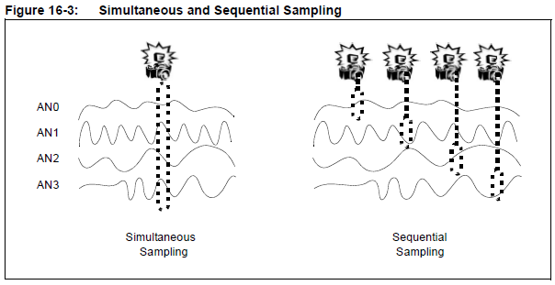
Sampling Mode
Up to 4 channels can be sampled simultaneously
Simultaneous sampling can be important in control and power calculations.
Notes:
You can configure how many sample and hold channels are going to be active for any mode. Choices are:
CH0 Only or
CH0, and CH1 or
CH0, CH1, CH2, and CH3
Remember in 12 bit mode there is only one sample and hold

